Slide 1

Heart Disease Prediction
Deepak Rai
9BEIM050

Slide 2
Overview
Objective
Dataset
Pre-processing
Algorithms used
Visualization
Results

Slide 3
Objective
Creating a simple web-based Heart Disease Prediction app using Streamlit. (https://www.streamlit.io)

Slide 4
Dataset
Heart Disease UCI dataset (https://www.kaggle.com/ronitf/heart-disease-uci)
14 classes (13 attributes and 1 target)
303 data entries
Binary classification 0 for no heart disease 1 for heart disease

Slide 5
Pre-processing
Training Data = 70%
Testing Data = 30%
Each categorical column broken into dummy columns with 1s and 0s.
Scaling the dataset entries with StandardScaler

Slide 6
Algorithms used
Support Vector Machine (SVM)
Logistic Regression
Random Forest

Slide 7
Visualization
Using Streamlit we plot on web:
- Confusion Matrix - ROC Curve - Precision-Recall Curve

Slide 8
Logistic Regression Results

Slide 9
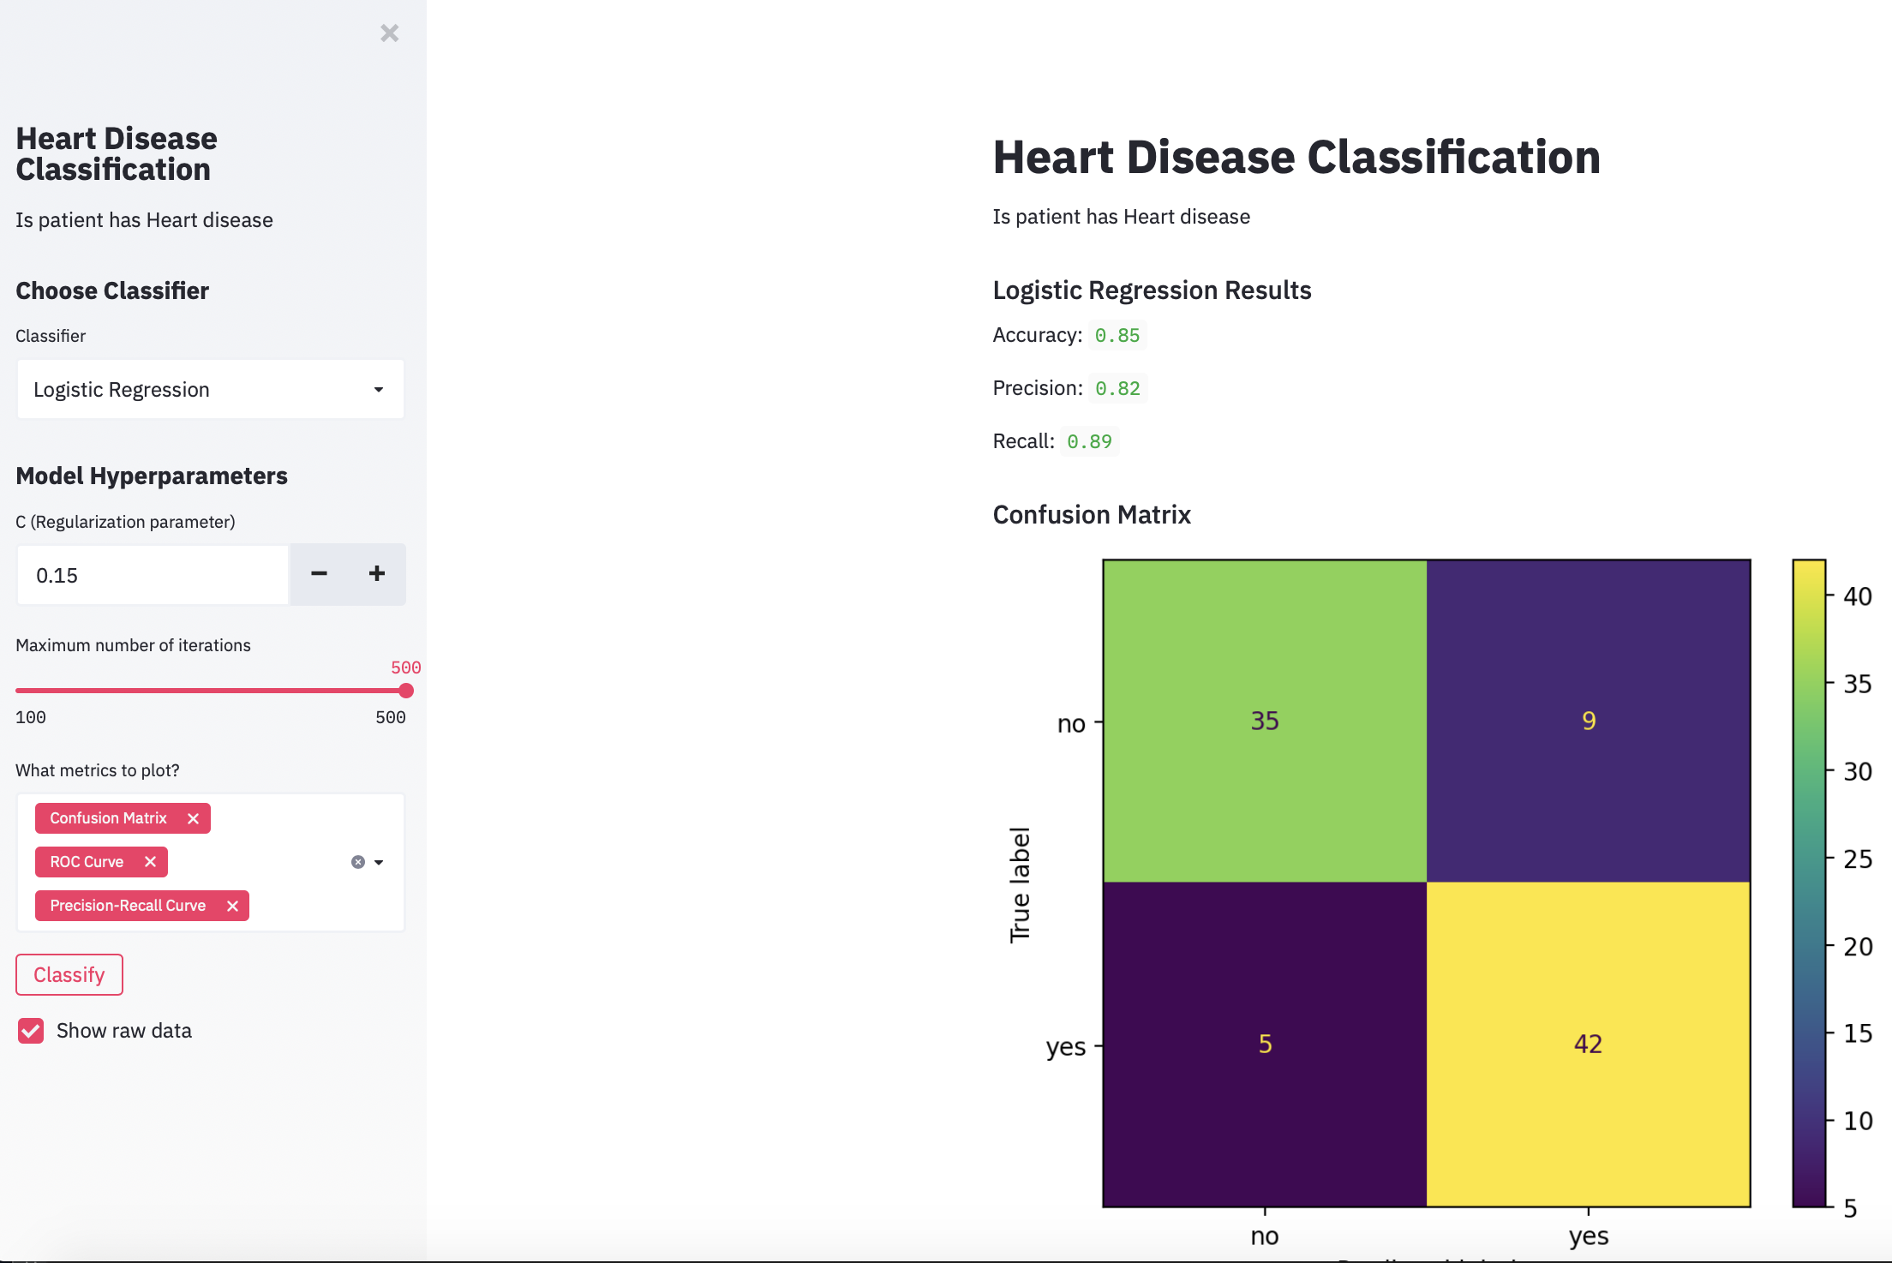

Slide 10
SVM Results

Slide 11
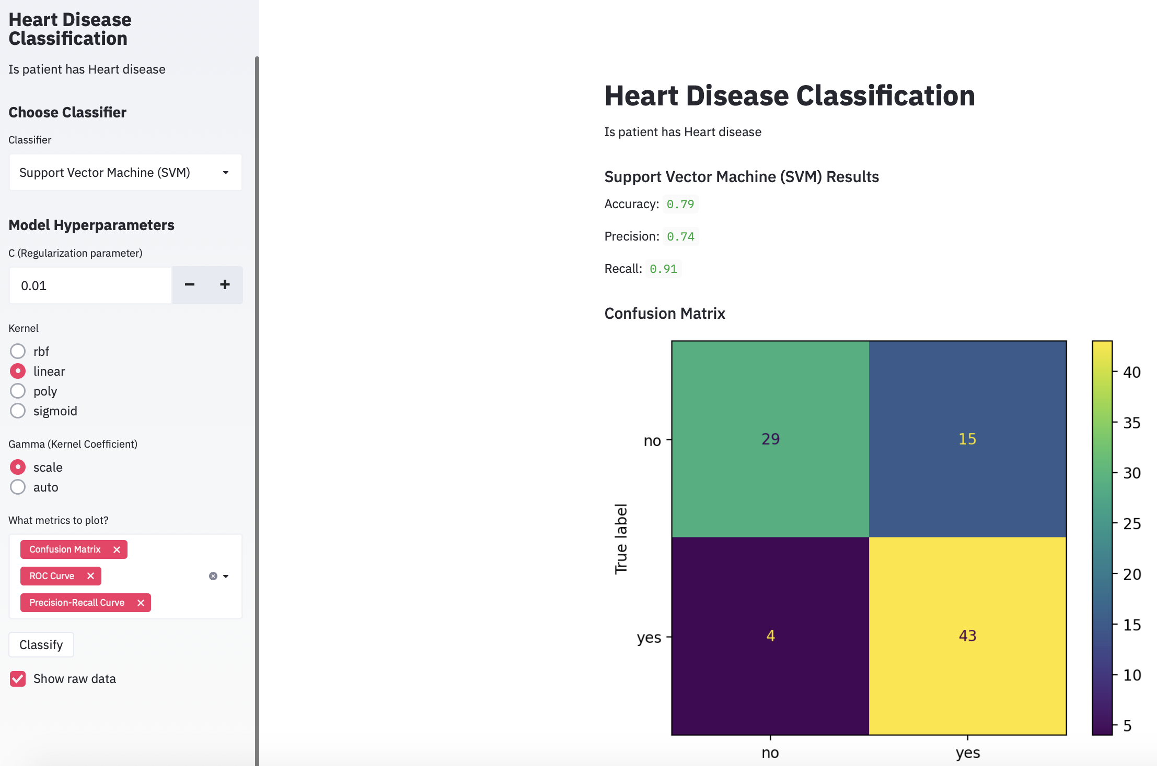

Slide 12
Random Forest Results

Slide 13
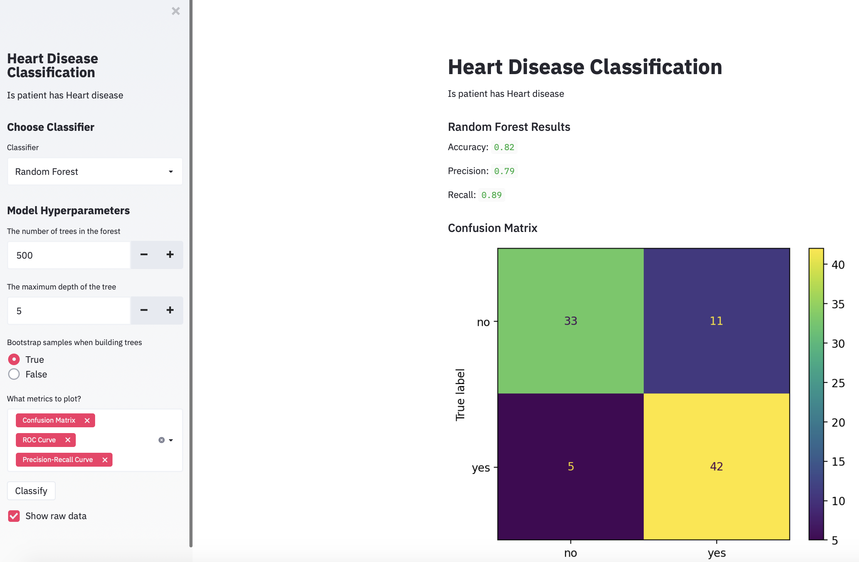

Slide 14
Code and References
To look at the code and references: https://github.com/djmk/Streamlit-UCI-Kaggle/tree/master/Heart%20Disease%20Data%20Set
Other References https://towardsdatascience.com/predicting-presence-of-heart-diseases-using-machine-learning-36f00f3edb2c

Slide 15
Thank you so much for your kind attention

